Slide 1



Analytical Model to Infer Mask Peripheral Leakage Pattern in Large Population
Akshay Anand¹, Tso-Kang Wang¹, Tomas Solano¹, Rajat Mittal², Kenneth Breuer³, Kourosh Shoele¹
1)FAMU – FSU (Florida State University)
^{2) Johns Hopkins University}
^{3) Brown University}
74th APS DFD Meeting, Phoenix, Arizona
11.21.2021

Slide 2
Outline
Introduction
Literature Review
Methodology
Results and Discussions
Effect of Number of Channels
Effect of Middle Area Periphery
Effect of Permeability Coefficient
Leakage Pattern for Facial Features
Conclusions and Future Work

Slide 3
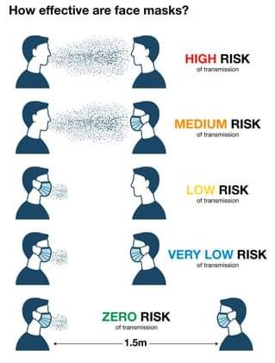
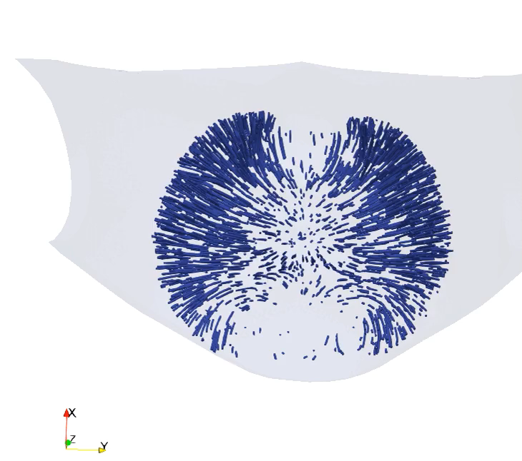
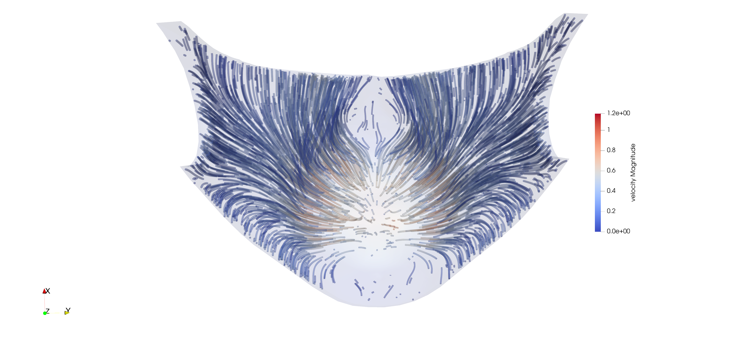
Introduction
Face masks have been crucial in our defense against COVID-19 & other pathogenic agents
Does one size of mask fit all?
What are the main factors affecting the effectiveness of mask?
Flow physics in the integral region between face and mask in large population

Slide 4
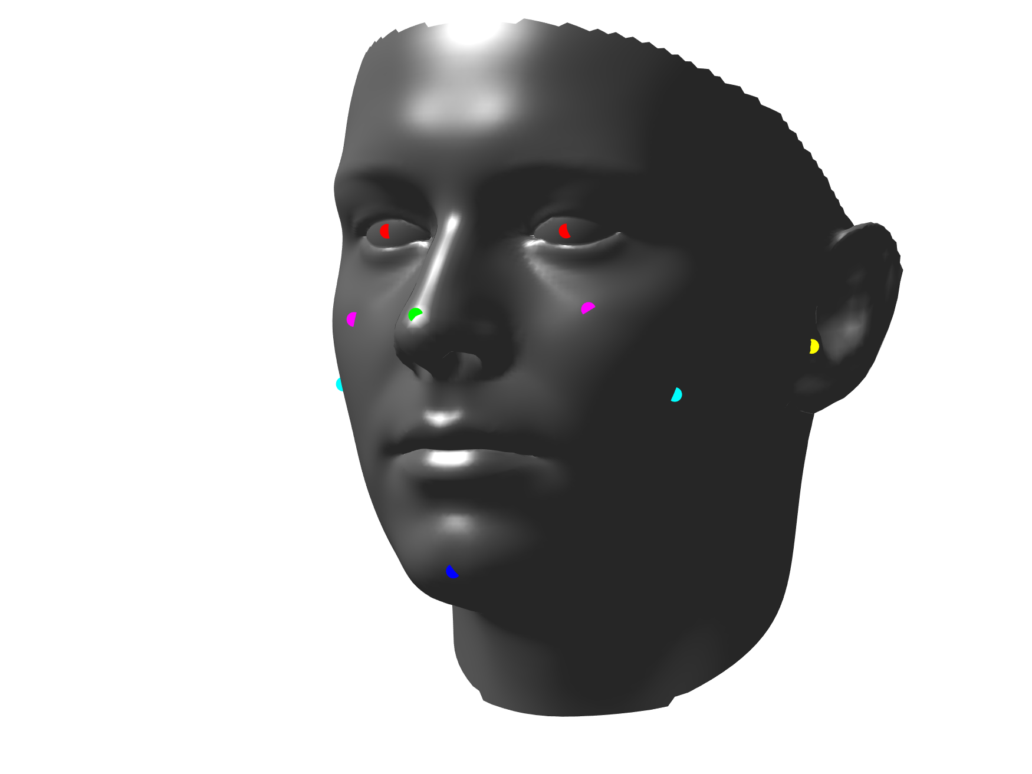
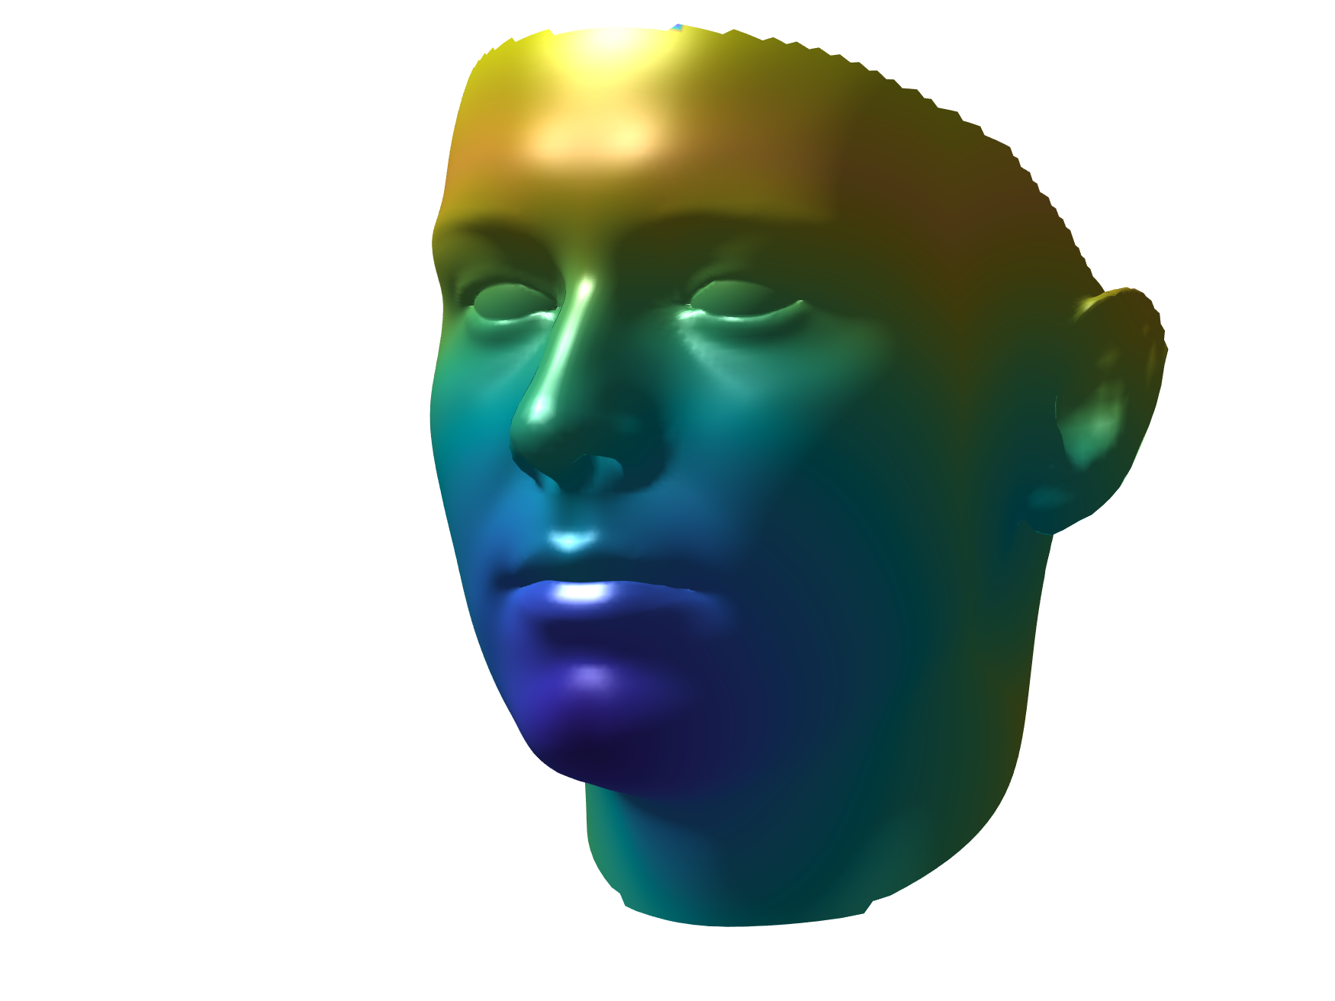
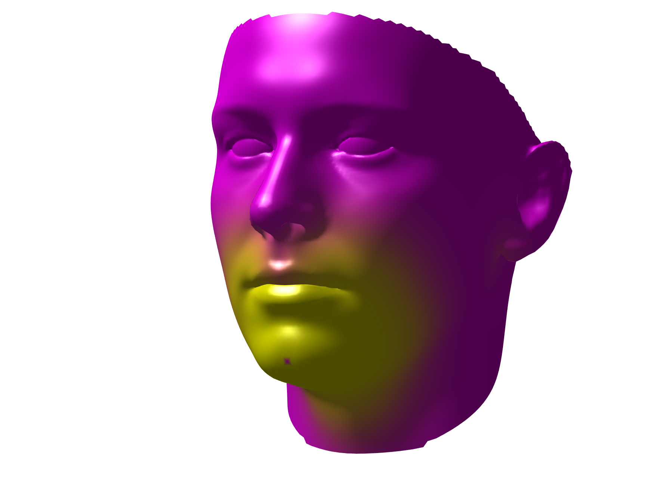
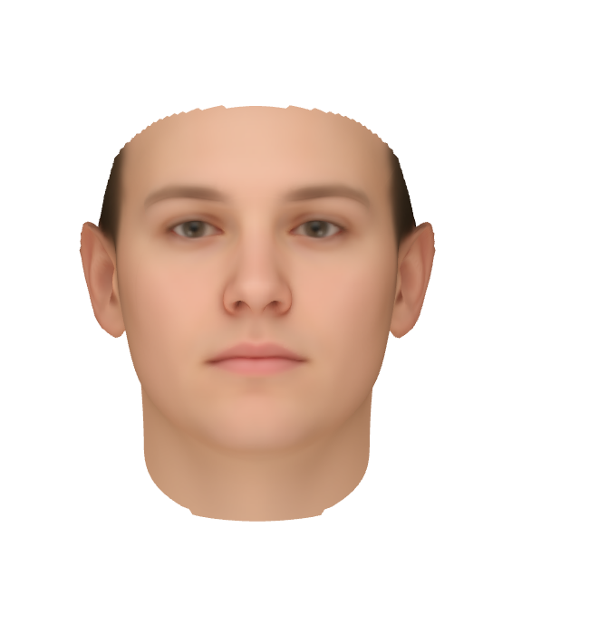
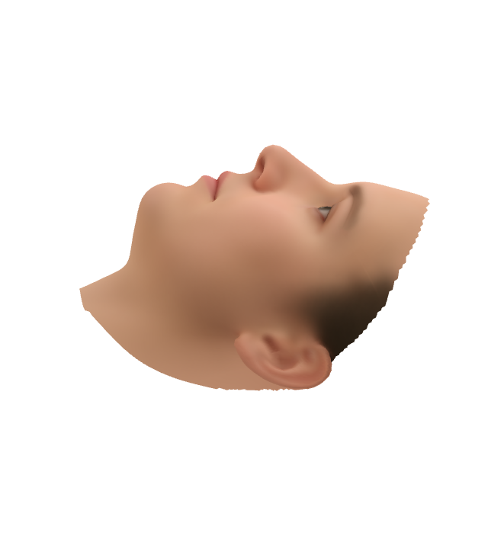
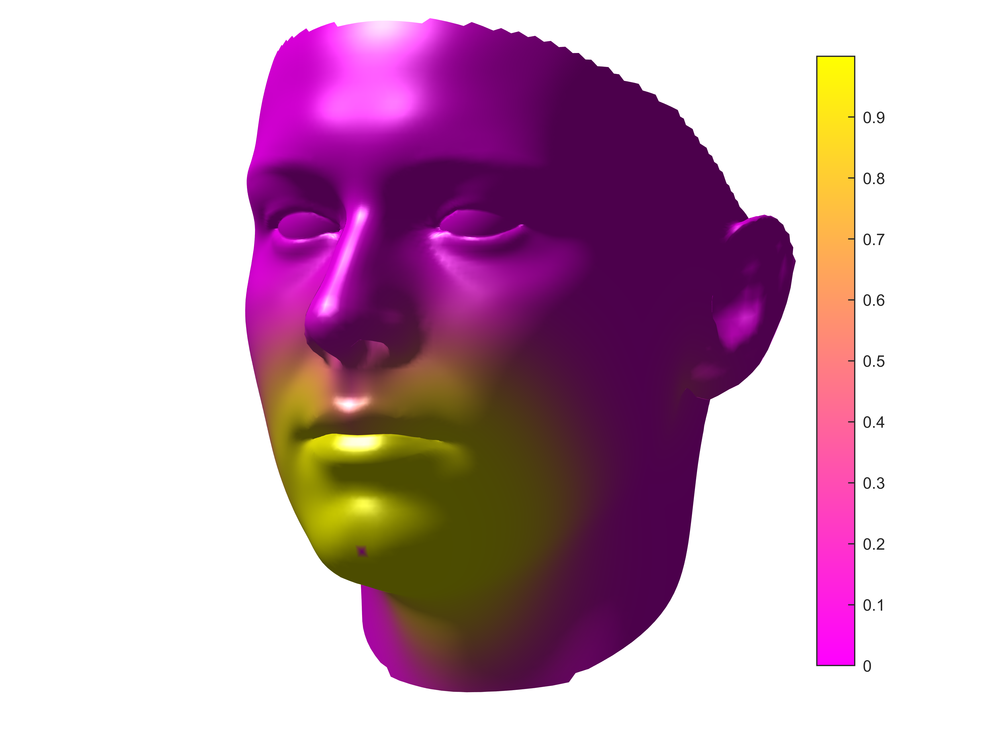
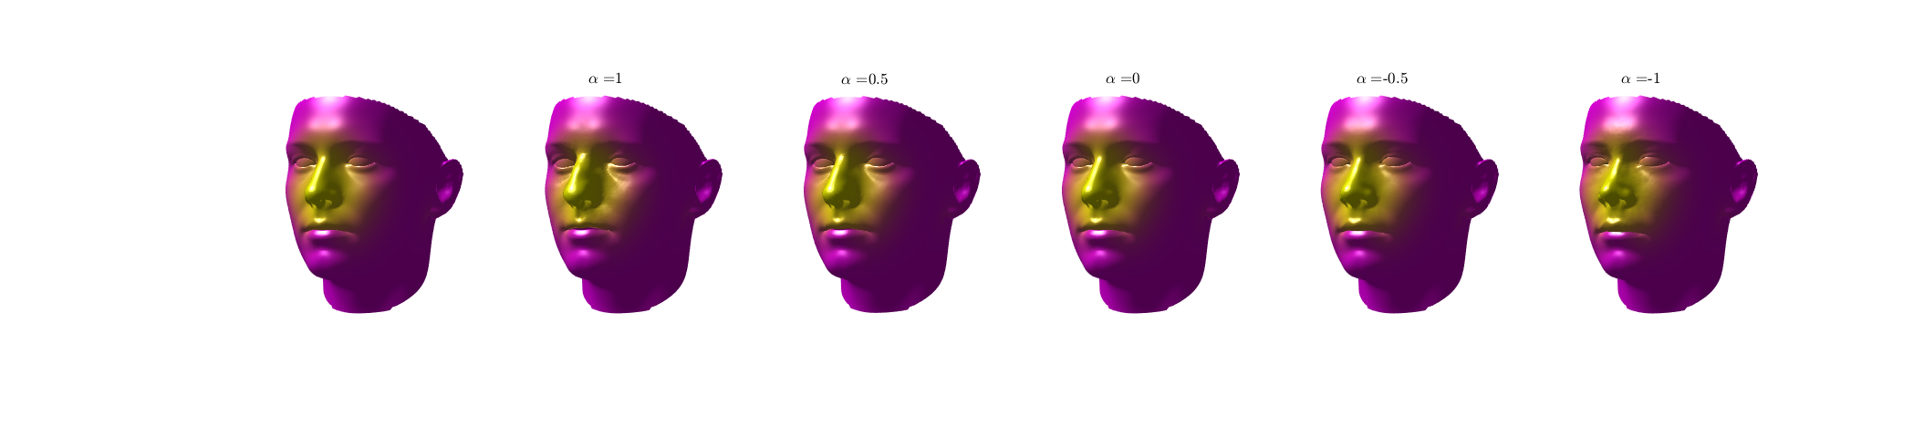
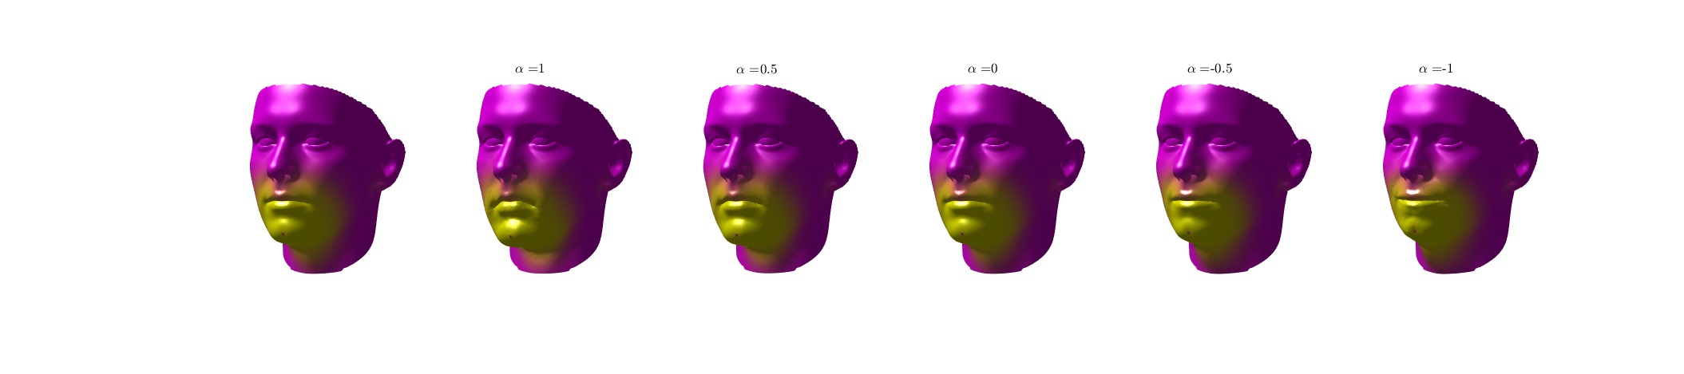
Mask Fitting Test Infrastructure
Geodesic weighting
Weighted PCA w.r.t. features
Attach masks to^{2,3} morphing faces
Correlation² relationship
Face database¹
A
B
C
D
1
E
Examples
0
Nose
Chin
[1.] Gilani et al. "Deep, dense and accurate 3D face correspondence for generating population specific deformable models. (2017)
[2.] Wang et al. "Bridge the Gap: Correlate Face Mask Leakage and Facial Features with 3D Morphable Face Models." (2021)
[3.] Solano et al. "One size fits all?: A simulation framework for face-mask fit on population-based faces." (2021)

Slide 5
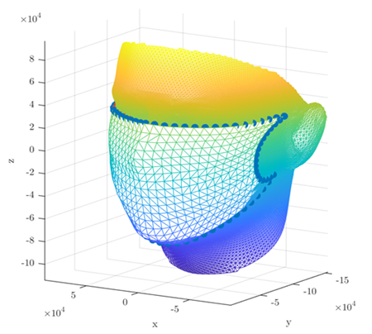
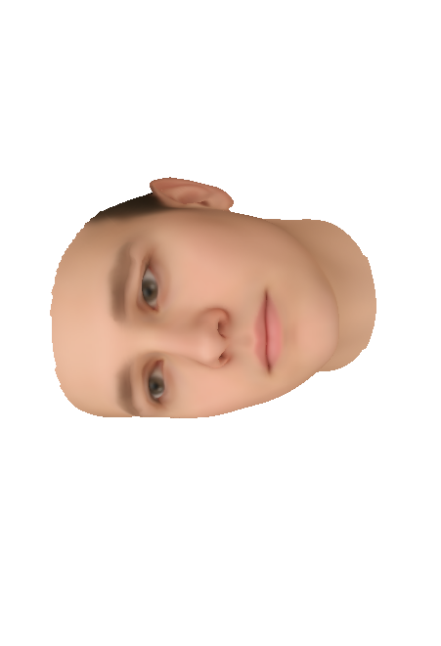
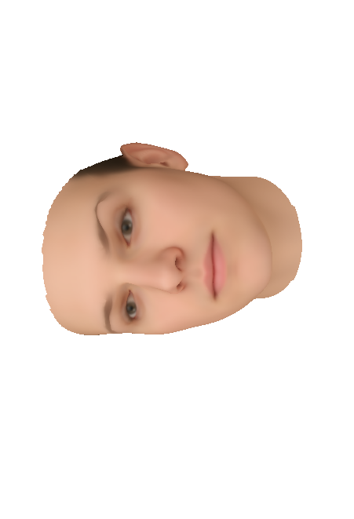
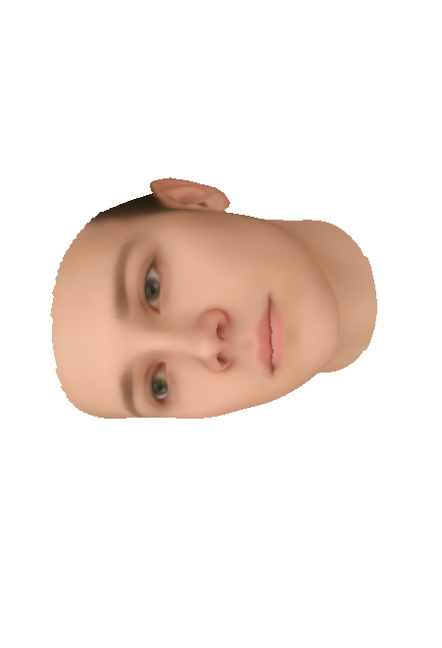

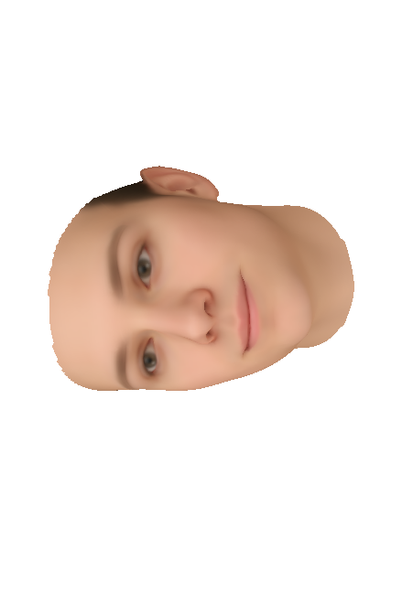
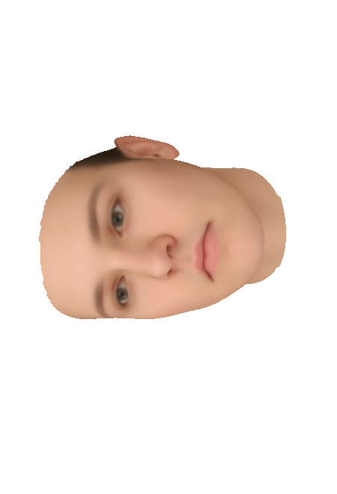
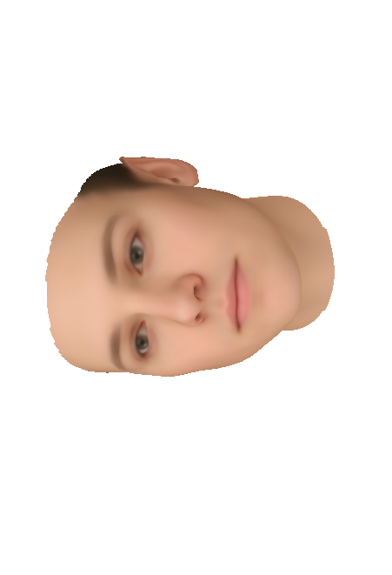
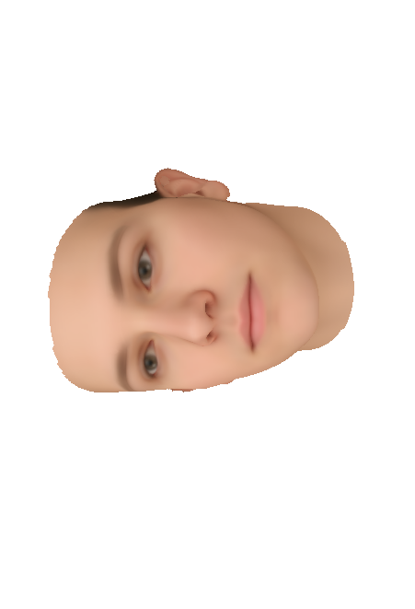

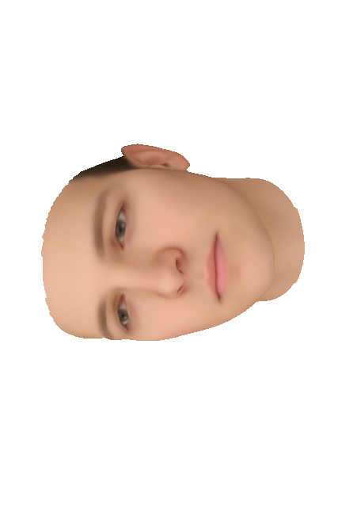

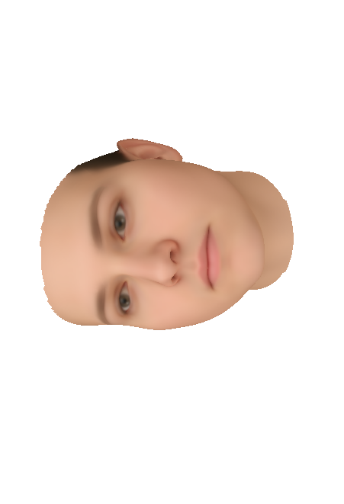
Weighted PCA w.r.t Features
Eyes
Nose
Chin
Ear
Zygomatic arch
Cheeks
Mask is a part of PCA modes, the mean face and the mask are modified together by PCA modes
Wang et al. JESEE, 2021

Slide 6
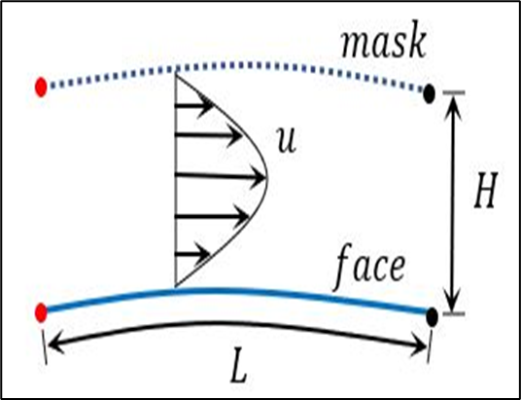
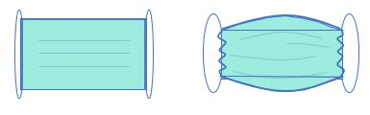

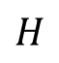
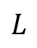
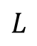
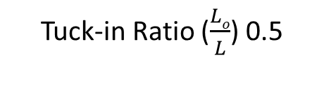
Problem Set-Up
$$L$$
9 X 5 in.
Mask with multiple porous channel having longitudinally varying height
1 . . . . . . . .
50
$$Lo$$
High
Pressure
$$H$$
$$L$$
Without tuck-in
With tuck-in
Geometry Schematics
Velocity Profile
Tuck-in Ratio ($\frac{Lo}{L}$) 0.5
If we know the solution for each mask; the velocity and pressure in channel are related to flux inside each channel
With the iterative process we solve the flow that goes through inner domain and flow that goes to each channel (redistribution happens at entrance of each channel)
This approach is used to compute the distribution of flow in each channel as well as the flow dynamics
[1.] Berman et al. “Laminar Flow In Channels with Porous Walls: J. Applied Physics (1953)

Slide 7
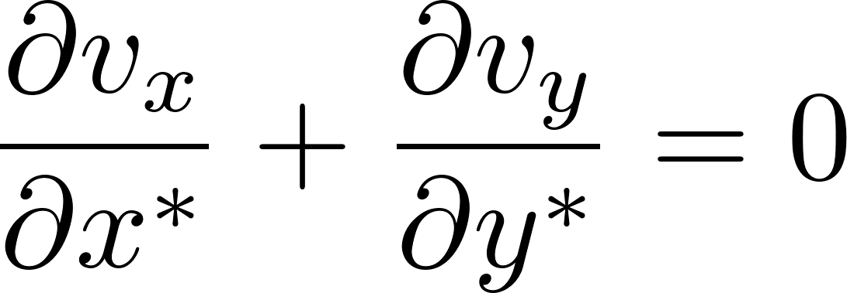
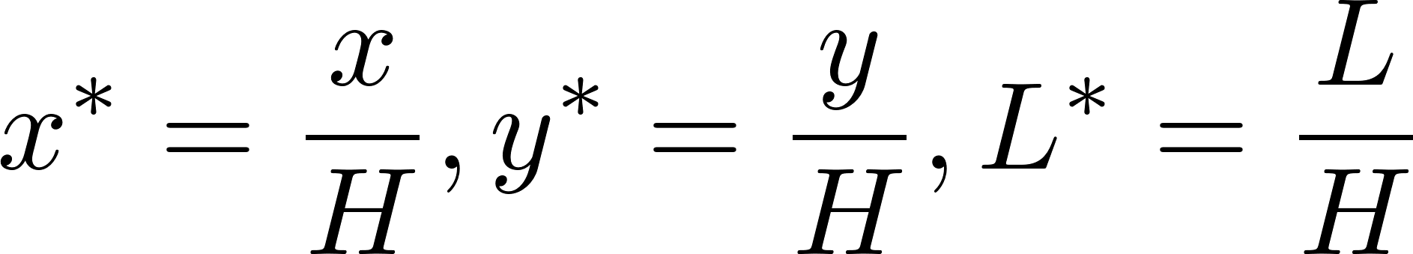
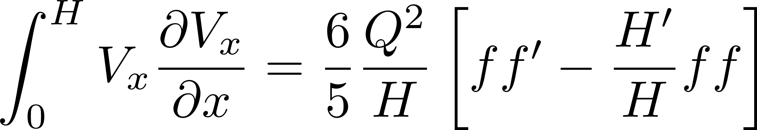
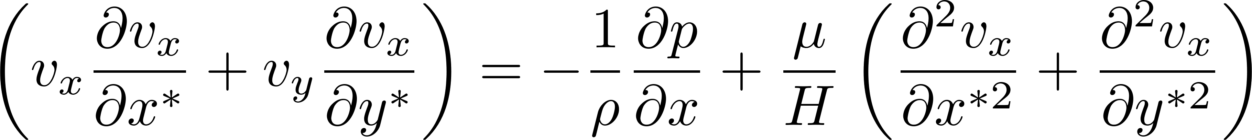
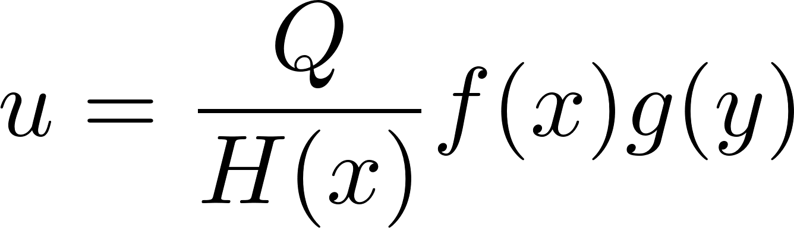
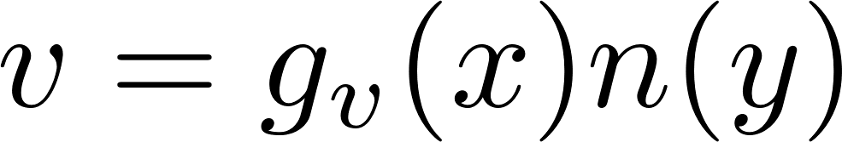
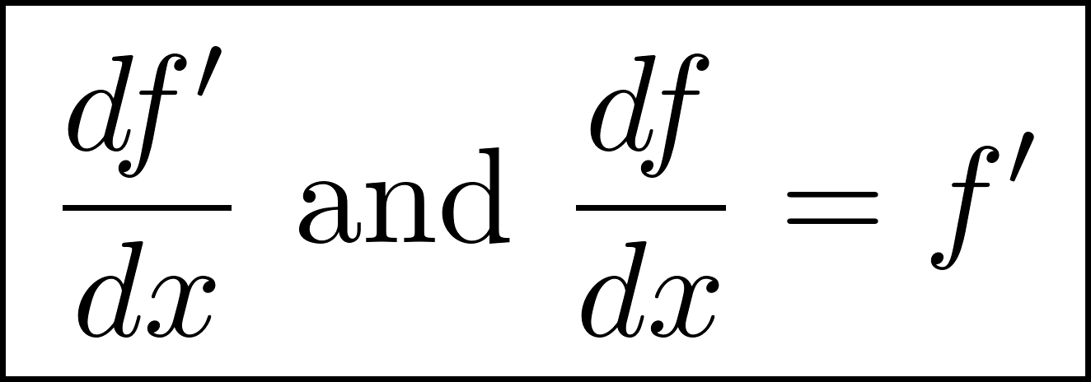
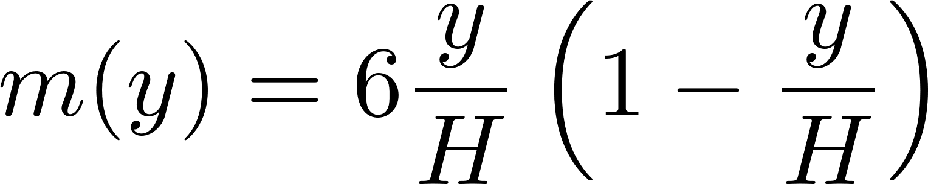
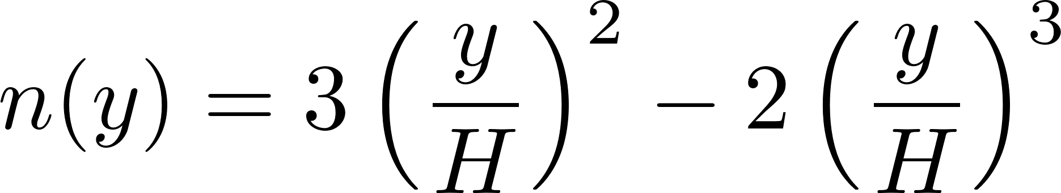
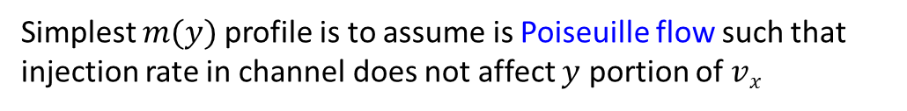
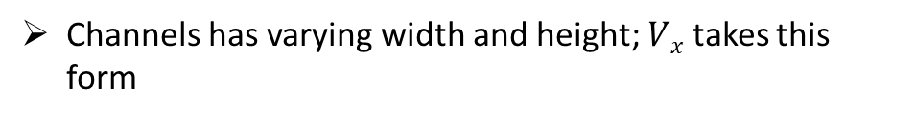

Governing Equations
We assume laminar flow inside the channels
Channels has varying width and height; $Vx$ takes this form
Flow through porous wall is governed by Darcy’s law
$$\frac{dp}{dx}=−k^{−1}\left(u−V\right)$$
Considering Kármán-Pohlhausen Momentum Integral² Technique
2nd order PDE into ODE; we solve for
$m(y)$gives the shape of velocity profile in $y$ direction
Von – Kármán-Pohlhausen Approximations for the fluid part
Iterative Approach for distribution of flux
Simplest $m(y)$profile is to assume is Poiseuille flow such that injection rate in channel does not affect $y$ portion of $vx$
The model was validated with the analytical channel flow data by Berman et al. (1953)
[1.] Berman et al. “Laminar Flow In Channels with Porous Walls” J. Applied Physics (1953)
[2.] Hartwig et al, “Analytical Model for Steady Flow Through a Finite Channel with one Porous Wall” Physics of Fluids (2014)

Slide 8
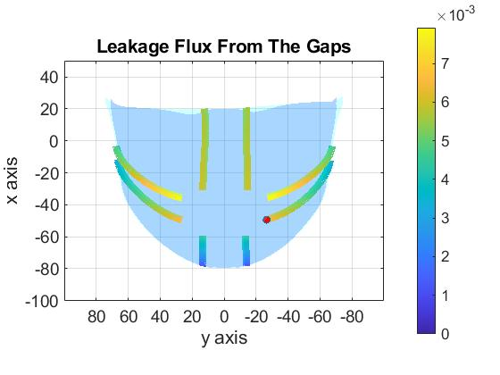
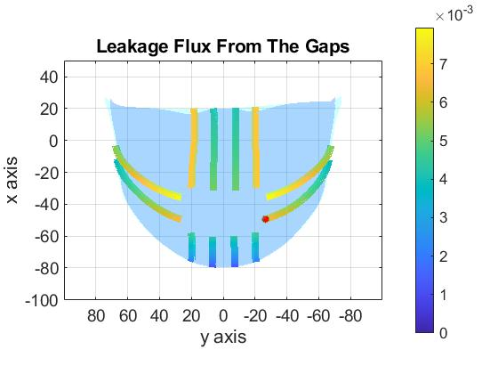
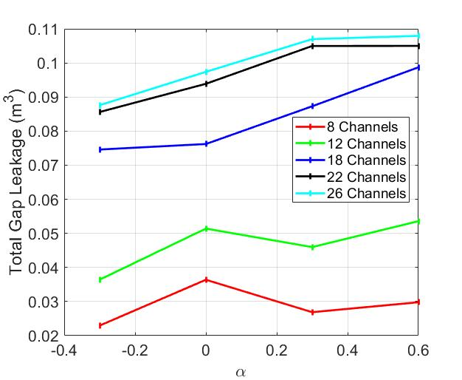
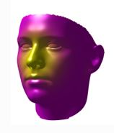
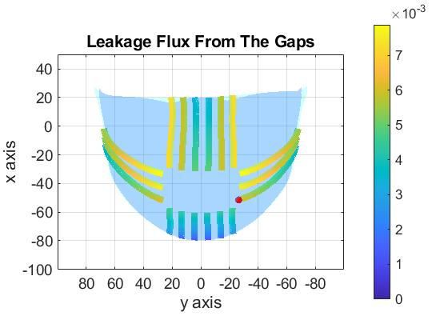
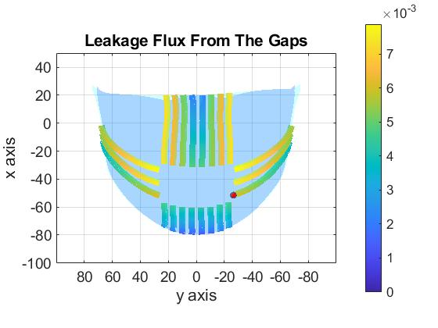
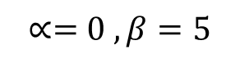
Optimal Number of Channels
#Channels = 08
#Channels = 12
#Channels = 18
#Channels = 22
Nose, Mean face
$$∝=0 , β=5$$
Twenty-two is the sufficient number of channel

Slide 9
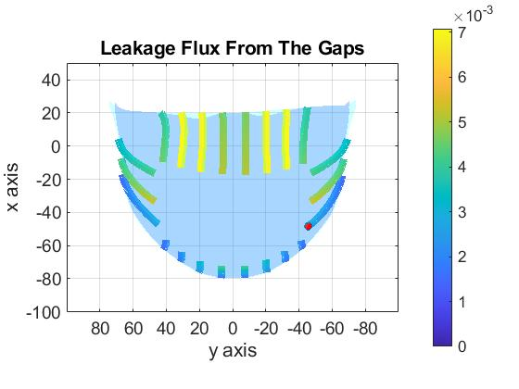
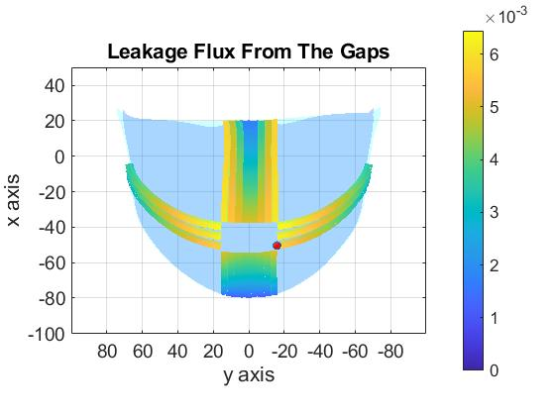
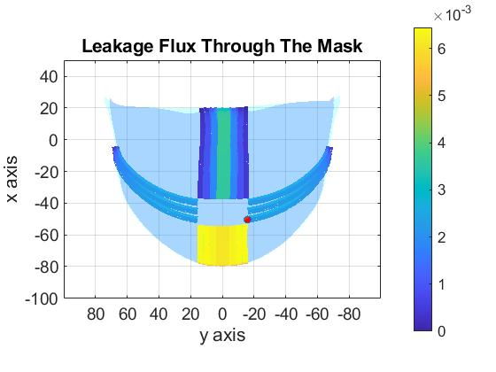
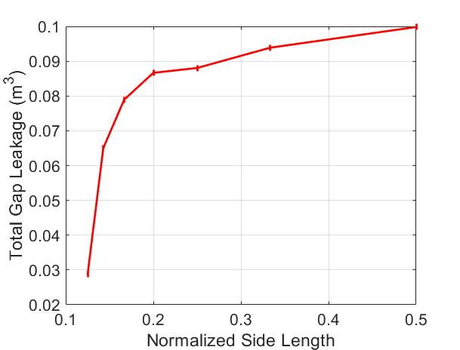
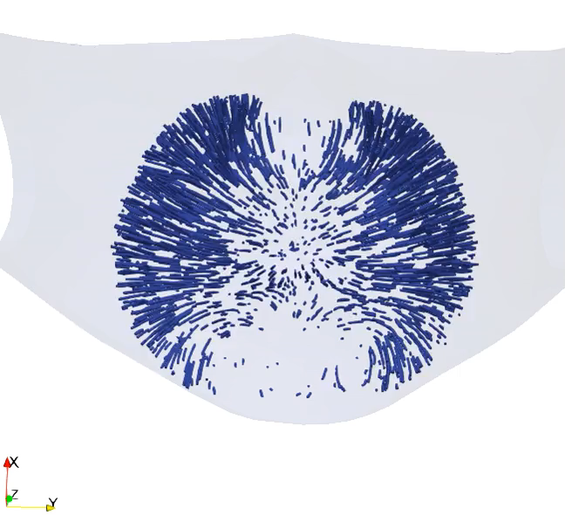

Effect of Inner Domain Periphery
Sides = S/2
Sides = S/4
Sides = S/8
S_{x} = S_{y} = S
S_{x}
S_{y}
Sides = S/8
S/4 is a good choice
Nose, Mean face
$$∝=0 , β=5$$
#Channel = 22
S Total Gap Leakage

Slide 10
















Effect of Permeability coefficient
$$β=0.1$$
$$β=1$$
$$β=5$$
$$β=10$$
$$β=\frac{k}{μ}$$
Nose, $β=5$
$$∝ =−1 to+1$$
# Channels = 22
$$∝ =−1$$
$$∝ =0$$
$$∝ =1$$
[1.] Aydin et al. “Performance of Fabrics for Home-Made Masks Against the Spread of Respiratory Infections Through Droplets: A Quantitative Study (2020)

Slide 11









Leakage Flux Through Facial Features
Forehead
Eyes
Nose

Slide 12







Leakage Flux Through Facial Features
Cheek
Chin
Leakage flux from the facial feature forehead and eyelines does not have significant contribution
Leakage flux from cheek and chin are more pronounced over other facial features

Slide 13


Conclusion and Future Works
Facial topology plays a significant role in the mask fitting on individuals face
Majority of flow (air, aerosols) leaks from the gap if mask fit is poor
Next, step is to connect these analysis with larger gaps and find correlation between different population
This approach can be used to quantify the flow
Developed model can be treated a multi-level component of computational framework to quantify the leakage pattern and mask efficacy

Slide 14
Acknowledgement
Funding Source:
This material is based upon work supported by the National Science Foundation under Grant No. CBET-2034992.Any opinions, findings, and conclusions or recommendations expressed in this material are those of the authors and do not necessarily reflect the views of the National Science Foundation
Thanks to the computing resources provided by Florida State University’s Research Computing Center (RCC)
Akshay Anand
aanand@fsu.edu

Slide 15



Back-up Validation
Constant Flux
Similar as Berman et al.
G Function
Flow through porous wall by Darcy
$$\frac{\tilde{F}\left(1−λ\right)}{δ}=\frac{dp}{dx}=−k^{−1}\left(u−V\right)$$
$$−k^{−1}=\frac{\left[c_{1}\int_{t}{(V−u)}dt+c_{2}\left(V−u\right)\right]\left(1−λ\right)}{δ\left(u−V\right)}$$
$c_{2}\left(V−u\right)≫c_{1}\int_{t}{(V−u)}dt$
$${k^{−1}≈\tilde{k}}^{−1}=\frac{c_{2}\left(1−λ\right)}{δ}$$

